Slide 1





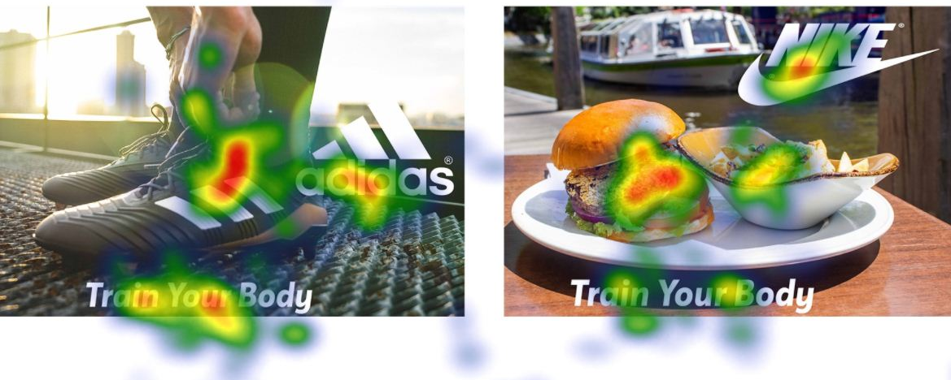
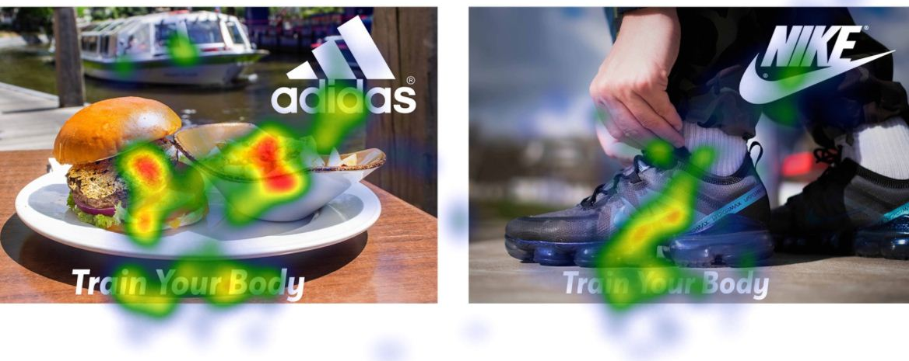








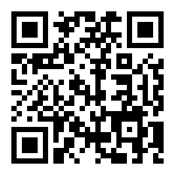
Introduction
When consumers receive messages about certain brands, they attempt to match the new information to their pre-existing cognition of the brand, in line with messages they previously received. In consequence, they are more likely to appreciate a meaningful – while congruent - new brand message.
Incongruence is the obvious difference or mismatch between new brand information and pre-existing perception of the brand, but which can also attract attention.
Results
Discussion
Sample
In H5 the dummy variable congruence / incongruence was regressed to predict PI and the LI A. As viewed in the table below the results were insignificant.
For H2 a regression model was constructed with VA (net dwell time in ms) as DV. The IVs were:
the congruence/incongruence dummy variable
the pre-existing LI
And the moderating interaction effect of the dummy variable and the pre-existing LI
The regression model is not significant F (3, 42) = .391, p > .05. The model is not able to predict VA (R²= .03). Dummy variable congruence/incongruence, b* = .19, t = .37, p > .05, 95% CI [-1980.91, 2873.54], pre-existing LI , b* = -.02, t = -.11, p > .05, 95% CI [-395.68, 356.67], interaction of pre-existing LI and dummy variable, b* = -.04, t = -.07, p = > .05, 95% CI [-544.56, 507.67].
Relevance
Both models answerring H2 and H5 were not significant. → Brand incongruity was not able to predict an increase in PI and LI A
Pre-existing LI measured in the pre-survey did not influence VA of participants
Though, the sample is very small (only N = 23 participants) of which all were University students
Under these conditions, it is hard to define an underlying factor influencing people’s behaviour and individual differences will be overemphasized
Limitations
Inaccuracy for participants using glasses → refraction of the light (eye-tracker uses pupil corneal reflection technique)
Systematic error present: head movements by participants
Contact lenses which were not able to be taken out during the experiment → greater discomfort otherwise
Setting of the experiment was in a very clinical environment, remote rather than head-mounted or tower eye tracker → improved comfort
DVs | Constant | R² | B* | t | p | 95% CI
 | 4.35 | .06 | - .25 | - 1.733 | .090 | [-1.79, .14]
 | 4.13 | .02 | - .14 | - .930 | .356 | [-1.24, .45]
Graphical Depiction of Research Model
Heatmaps
Future Studies
Wider variety of participants
Influence of the 2 brands employed regarding PI and LI A and LI B.
Constructed brand by researchers (incl. background information for participants) → Reduced interference of the brands, focussing on in-/ congruence of the adverts.
H5
Would Incongruence Grab your Attention?
H2
Method
Measures
Visual Attention (VA): Dwell Time in ms on the AOI (Area of Interest)
Likeability of the brand (LI B):
Pre-existing affinity to the brand assuming a moderating relationship between the stimulus and the visual attention in H2. Likeability is described in 4 dimensions, according to Nguyen. The original 17 items of the 4 dimensions were reduced to:
Positive association: “The brand is associated with a positive motive”
Interaction interest: “I feel attached to the brand”
Personified quality: “This brand is very attractive”
Brand contentment: “Overall, I approve of this brand”
Purchase intention (PI):
One of the main DVs in the 5th Hypothesis, the other being likeability of the ads. The theory of planned behaviour by Ajzen (1991) was used culminating in the question “How likely are you to purchase products from the sports brands that you saw on the picture?”.
Likeability of the ads (LI A):
In the post-survey the question was asked on a 7-point Likert scale “Please indicate your likeability of the advertising pictures of the sports brands.” This variable was then used as a DV in the 5th Hypothesis.
Congruence Incongruence dummy:
Two sports brands Nike and Adidas were chosen, as they are well known and two brands are able to provide a better generalizability and external validity is higher. Participant was simultaneously exposed to the congruent and the incongruent picture.
The Blind Spot: Janice Butler
Tool & Procedure
Given the specialty of the eye-tracking technology, the researchers employed the tool to discover consumers’ attention and behaviours in market research.
Since the pre-existing LI B displayed (Adidas and Nike) is taken as a moderator, the accompanying survey was split into pre- and post-surveys.
In the pre-survey, demographic information (age, sex, disposable income, education) was collected.
After the pre-survey participants the eye-tracking survey was conducted with exposure to the stimulus material for a set time of 7 seconds.
Where possible glass-wearers were asked to remove their spectacles.
Afterwards the participants completed the questionnaire, answering questions about their PI and LI A.
Sample
2 groups: The 1st half of the participants
Nike incongruence
Adidas congruence adverts
2nd group:
Nike congruence
Adidas incongruence adverts.
11 BA students, & 12 MA students.
Due to time and financial constraints, a nonprobability sampling method (i.e. convenience sampling) was used.
Research Questions
RQ: How do brand messages, that are incongruent with the established social image of the brand, differ from brand messages that are congruent with the brand image in terms of affecting individual purchase intentions through visual attention?
RQ2: How does pre-existing likeability towards the brand influence the brand-incongruity effect on purchase intention?
Hypotheses
H2: Higher, pre-existing likeability towards the brand will result in higher visual attention on the visuals
H5: Compared to brand-congruity, brand-incongruity will overall lead to an increase in purchase intention and likeability of the brands.
N = 23
References:
Ajzen, I. (1991). The theory of planned behavior. Organizational Behavior and Human Decision Processes, 50(2), 179–211. doi: 10.1016/0749-5978(91)90020-T
Nguyen, B., Ekinci, Y., Simkin, L., & Melewar, T. C. (2015). The Brand Likeability Scale: An Exploratory Study of Likeability in Firm-Level Brands. International Journal of Market Research, 57(5), 777–800. doi: 10.2501/IJMR-2015-063 18.03.2020

